Slide 1

Rider Conversion Analysis
By Arkajyoti Basu Ray
March 15, 2026
Marketing analytics team

Slide 2
Agenda
ABOUT COMPANY
OVERVIEW
DATA SOURCES
PROCESS
FINDINGS
RECOMMENDATIONS
CLOSING

Slide 3
About Company
In 2016, Cyclistic launched a successful bike-share offering. Since then, the program has grown to a fleet of 5,824 bicycles that are geo-tracked and locked into a network of 692 stations across Chicago.

Slide 4
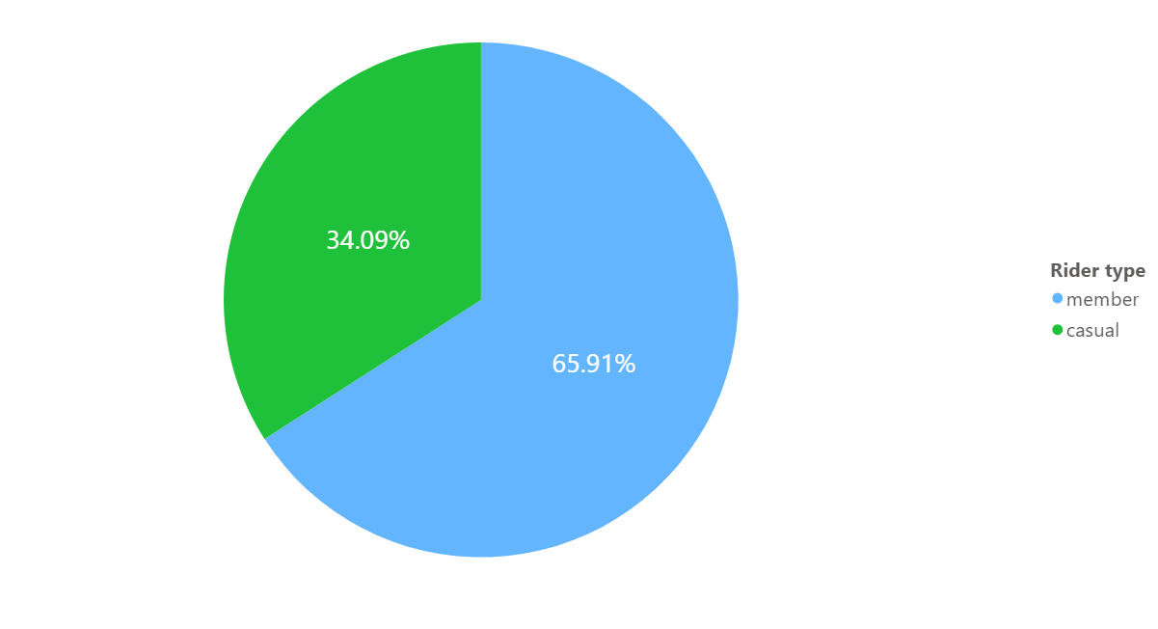
OVERVIEW
The primary goal is to identify the key behavioural differences between casual riders and annual members using their current usage pattern to provide data-driven recommendations for a new marketing strategy aimed at converting casual riders into long-term subscribers.
Why would the 34% of Casual riders buy a Cyclistic Annual Membership?

Slide 5

Data Sources
The data sources contains 12 months of historical trip data FY 2025-26 with-over 3.6 Million+ data entries . The data has been made available by Motivate International INC. under this license.
The data sources incur no bias and the data is credible, passing the ROCCC test.

Slide 6
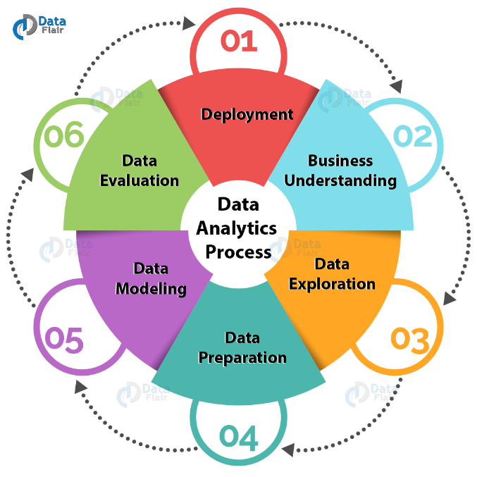
Process
Data Cleaning: The initial data cleaning phase affirmed the presence of no duplicate rides. The data-time formats over the 12 months data were formatted to a single format.
Although the data consisted of around 1,154,696 null entries, these rows were excluded from final analysis to ensure accuracy for location-based insights. However, initial checks confirmed there were no bias in the final data.

Slide 7
Feature Engineering
EDA
Feature Engineering: Data columns such as ride length and days of the week rides taken were created from the 12 months data for weekly, monthly and hour-wise analysis based on weekdays and weekends.
Exploratory Data Analysis: Graphs and data tables created to analysis the behavioral differences between casual and annual member riders.

Slide 8
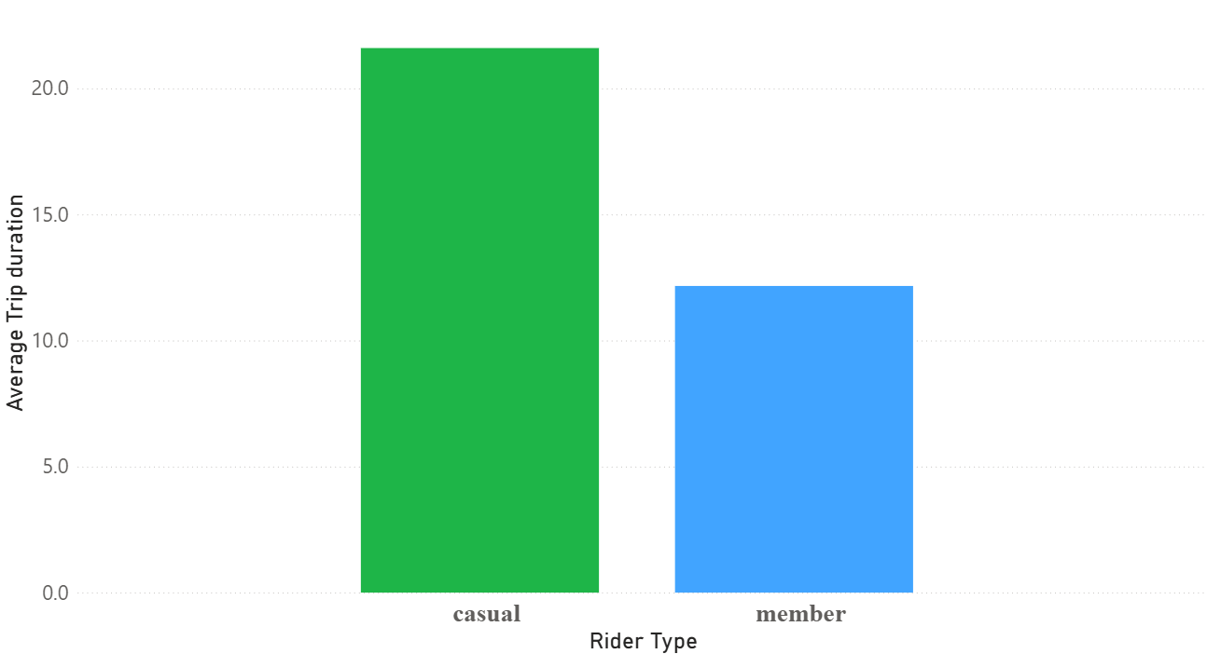
Findings
Casual riders prefer Leisure trips over Member riders who generally are commuter riders.

Slide 9
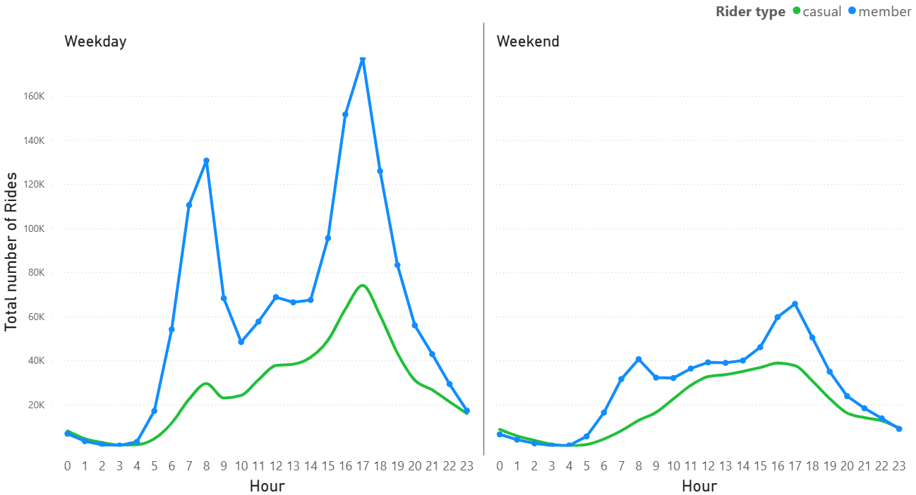
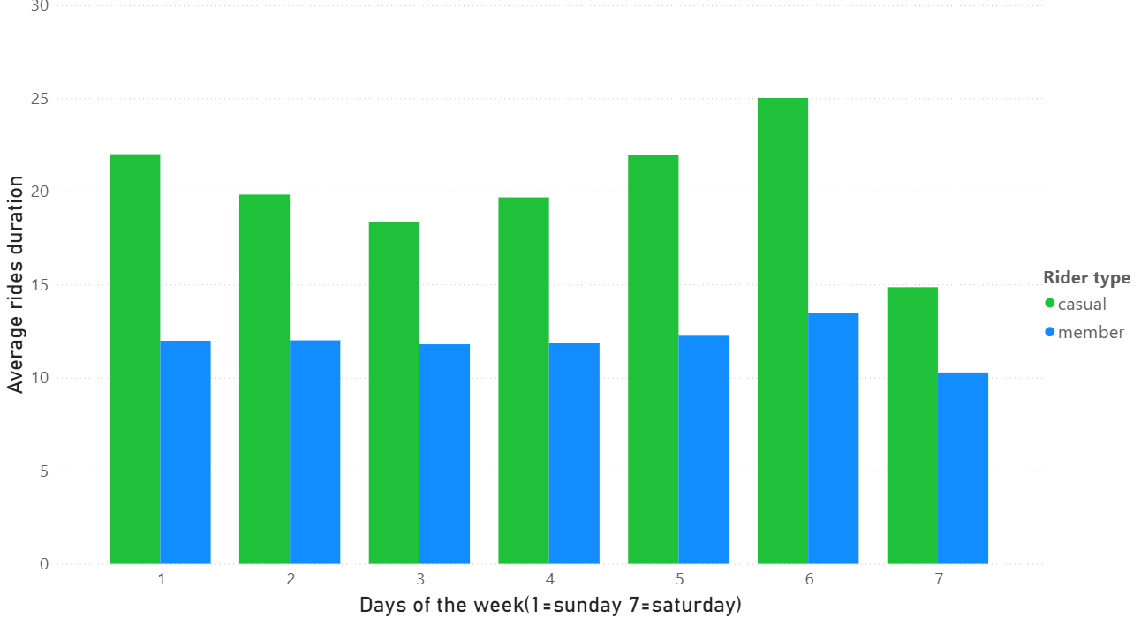
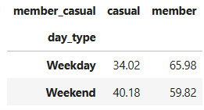
Casual rides peak consistently during 10 AM – 5 PM unlike member riders who generally ride at 8 AM or 5 PM
Casual riders prefer Weekends for over Member users who remain consistent.

Slide 10
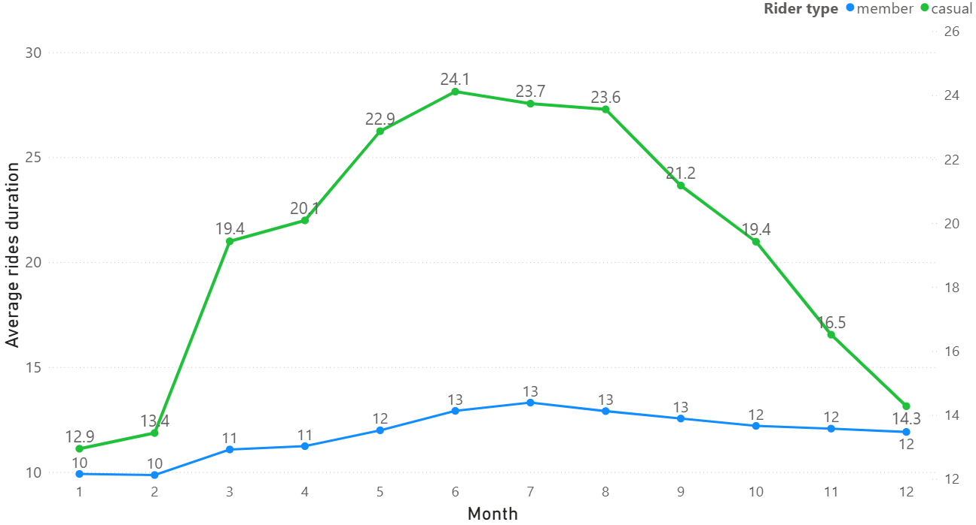
Casual riders consist of tourist trips during the Summer season (May-August) unlike Member riders

Slide 11
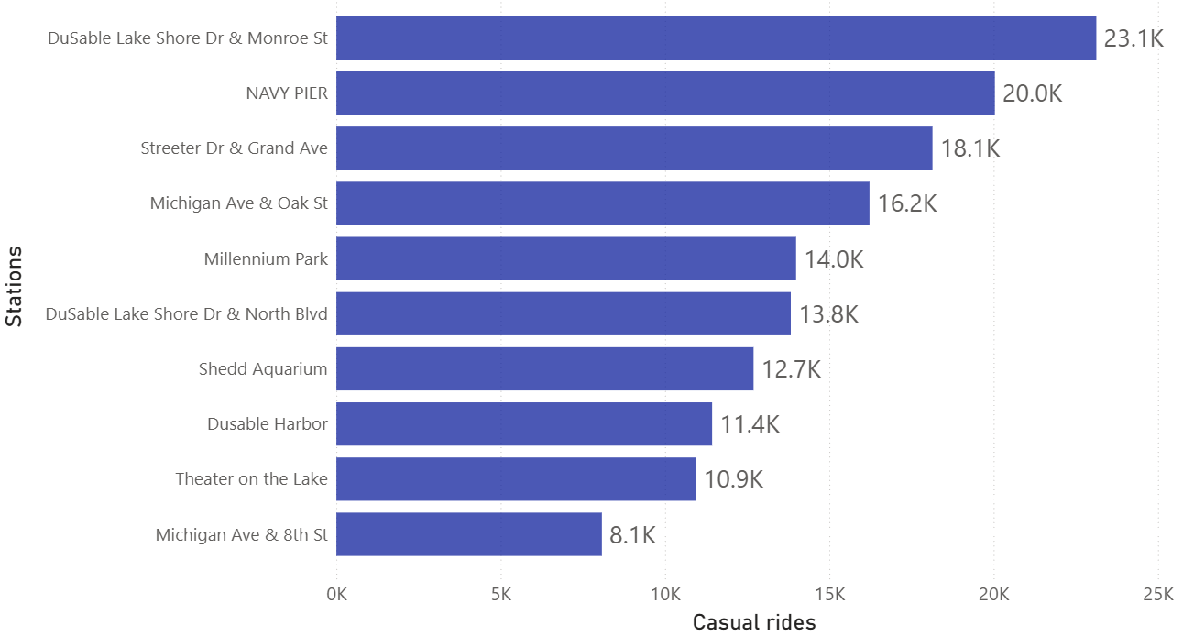
TOP 10 Casual Riding Stations

Slide 12
WHY CASUAL RIDERS WILL BUY MEMBERSHIPS?
Casual riders prefer leisure rides therefore an Annual Pass might help them avoid price anxiety. They can keep biking longer without worrying about the bill.
Many casual riders are seasonal commuters so If Seasonal passes are introduced, they would find it cheaper than paying daily per-minute rides.
Casual rides peak show a 6% increase in Weekends over Weekdays so Weekend Warrior passes would definitely be beneficial to them.

Slide 13
Recommendations
Introducing a Seasonal Leisure passes capture the high-volume Casual riders during the Summer seasons.
Offering first trial memberships to casual riders for Weekend trips during peak hours 10 AM to 5 PM.
Deploy digital advertisements on the Top 10 Casual rider Stations, highlighting the cost-savings of an annual member over casual riding.

Slide 14
Thank you
Questions?

